Slide 1
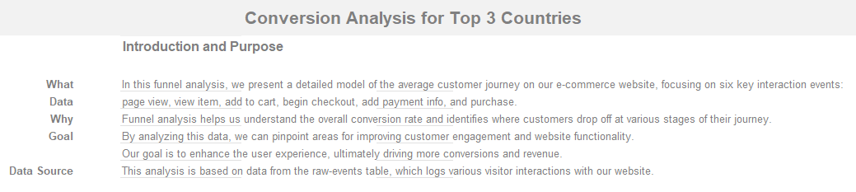

Slide 2
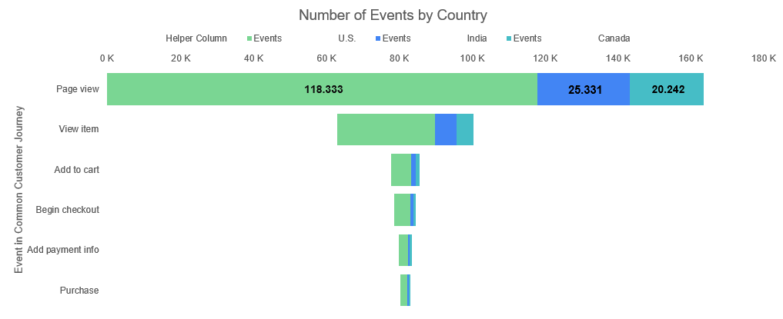
Top Countries by Number of Events:
U.S., India and Canada

Slide 3
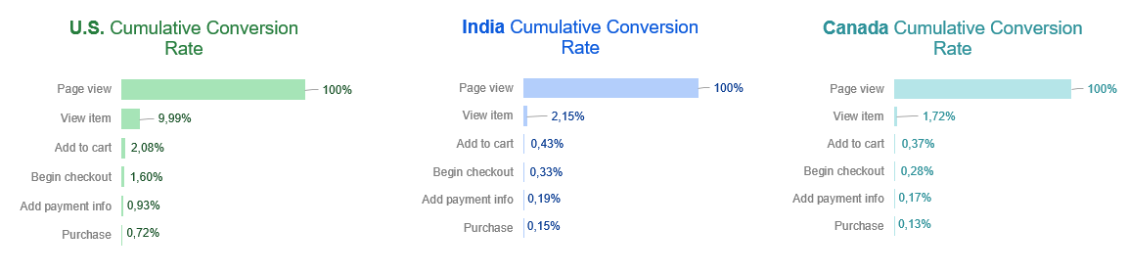
Cumulative Conversion Rate Breakdown Top 3 Countries

Slide 4
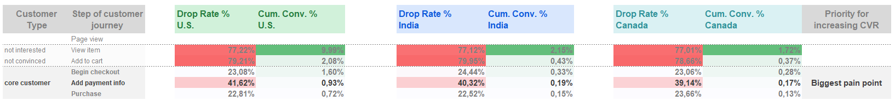
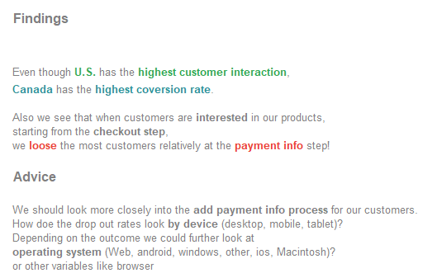
Cumulative Drop Rate vs Conversion Rate Top 3 Countries

Slide 5
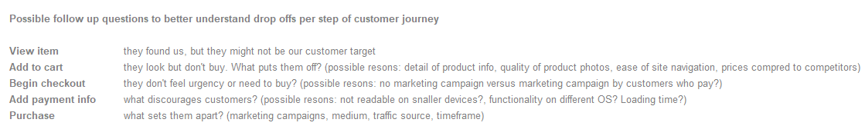
Cumulative Drop Rate vs Conversion Rate Top 3 Countries

